Slide 1


Parch and Posey Paper Sales Analysis (GROUP 4)

Slide 2




Contributors:
Salako Adesewa Adeyinka
Chisom Ogene
Lateefah Adedeji
Noreino Benison

Slide 3
PROJECT OVERVIEW
This project focuses on conducting an exploratory data analysis (EDA) on the Parch and Posey dataset, utilizing SQL for data querying and analysis. The goal is to uncover valuable insights into the company's business performance, identify top buyers, and analyze sales trends over time. Through detailed SQL queries and data exploration, this project aims to provide actionable insights to support data-driven decision-making and enhance overall business strategy.

Slide 4
OBJECTIVES
Sales Performance Monitoring
Regional Sales Insights Generation
Annual Sales Trends Identification
High-Value Transactions Identification
Communication Channel Analysis

Slide 5
METHODOLOGY
The Parch and Posey database was used as the foundation for this project, which focuses on analyzing sales performance across three paper products: standard paper, poster paper, and gloss paper. The dataset spans five years, from 2013 to 2017, with all monetary values expressed in U.S. dollars. The database contains five key tables: accounts, orders, sales_reps, web_events, and region.
To derive meaningful insights from the data, a combination of SQL and data visualization tools were used.

Slide 6
METHODOLOGY (CONT.)
Data Extraction and Transformation (SQL): SQL, specifically with the PostgreSQL Database Management System (PostgreSQL DBMS), was employed to extract, filter, and manipulate data across the tables. Queries were written to perform operations such as aggregating sales data, identifying top customers etc.
Data Visualization (PowerBI): PowerBI was utilized to create dynamic and visually appealing dashboard that showcases the key performance indicators (KPIs). The visualization allowed for an in-depth understanding of sales trends over time, top customers, and sales channel usage.

Slide 7
METHODOLOGY (CONT.)
3. Reporting (Microsoft PowerPoint): A detailed report was created in Microsoft PowerPoint, summarizing the insights gathered from the analysis.

Slide 8
DATASET OVERVIEW
Accounts Table: Contains information on the details of accounts that patronized the parch and posey company.
Orders Table: Includes revenue generated from each paper and the date the orders were made.
Sales Representatives Table: Provides information on sales representatives for accounts buying from the parch and posey company and their respective regions.
Web Events Table: Records information on channels used to contact the company.
Regions Table: Includes the name of various regions and their identification number.

Slide 9
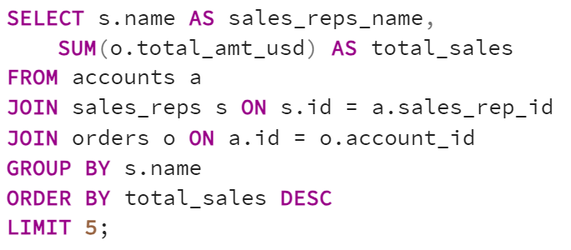
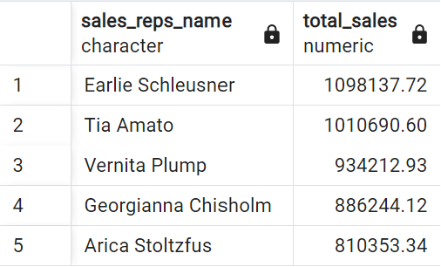
QUESTIONS AND INSIGHTS
1. Which 5 sales representatives are bringing the highest sales volume?
The result shows a strong performance, especially from the top 2 sales representatives with Earlie Schleusner and Tia Amato surpassing $1,000,000.

Slide 10
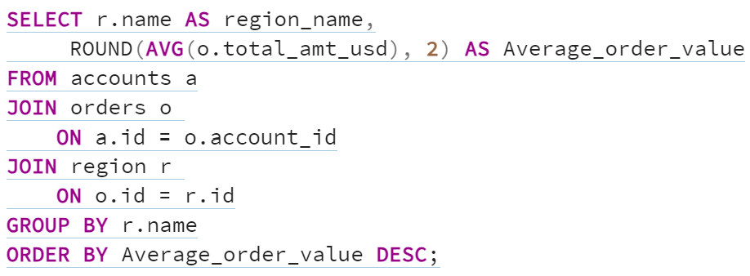
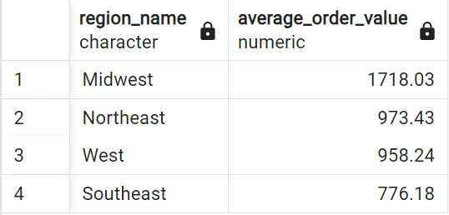
2. What is the average order value by region?
Midwest has the highest average order value at $1,718.03.
Northeast follows with $973.43, showing a significant drop compared to the Midwest.
Southeast has the lowest average order value at $776.18

Slide 11
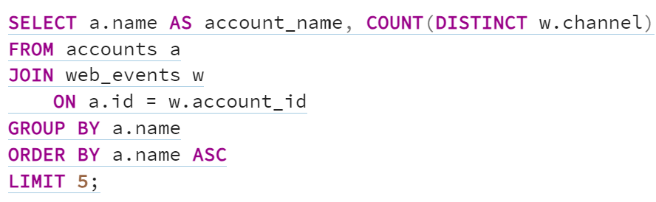
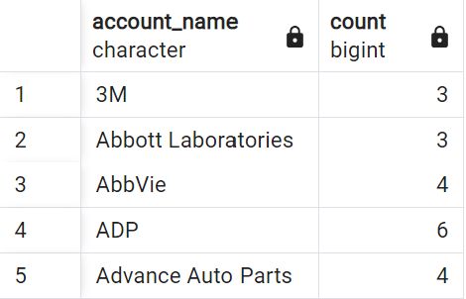
3. Retrieve the number of times each customer used the companies channel
There's a balance between high-frequency (6 visits), mid-level (4 visits), and lower-frequency (3 visits) accounts, suggesting varied levels of engagement with the supermarket.

Slide 12
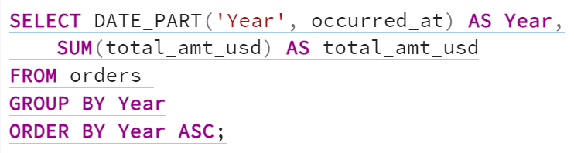
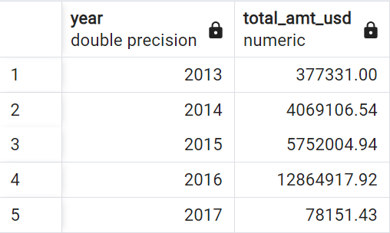
4. What is the Total amount of sales made yearly?
2013: The total amount was $377,331.00.
2014: Significant increase to $4,069,106.54.
2015: Further growth to $5,752,004.94.
2016: Sharp jump to $12,864,917.92, the peak amount.
2017: Considerable drop to $78,151.43.
Trend: The data shows an increasing trend from 2013 to 2016, followed by a significant decrease in 2017.

Slide 13
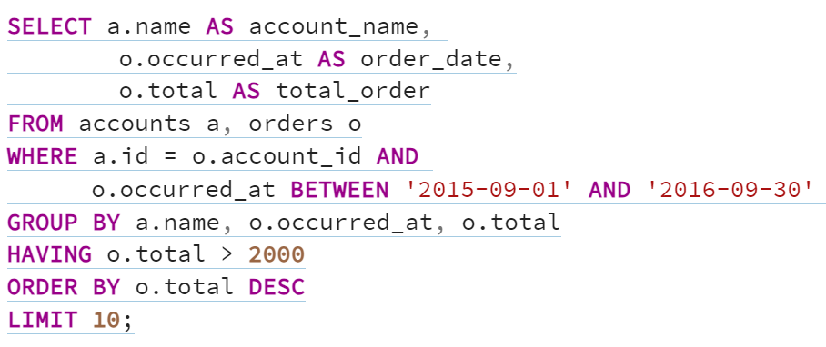
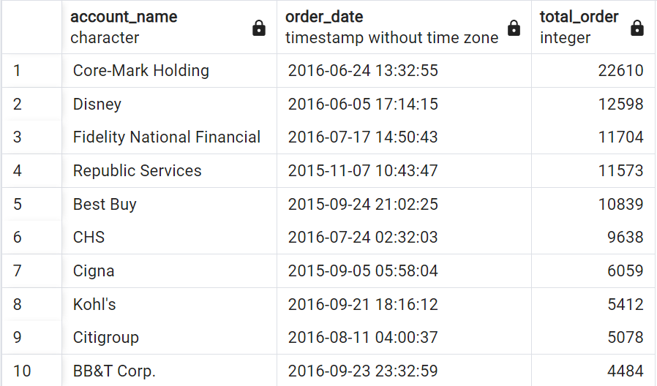
5. Find the top 10 accounts that purchased orders greater than 2000 between september 2015 and 2016
Core-Mark Holding leads with 22,610 total orders in June 2016.
Also, high orders were made in 2016 compared to 2015.

Slide 14
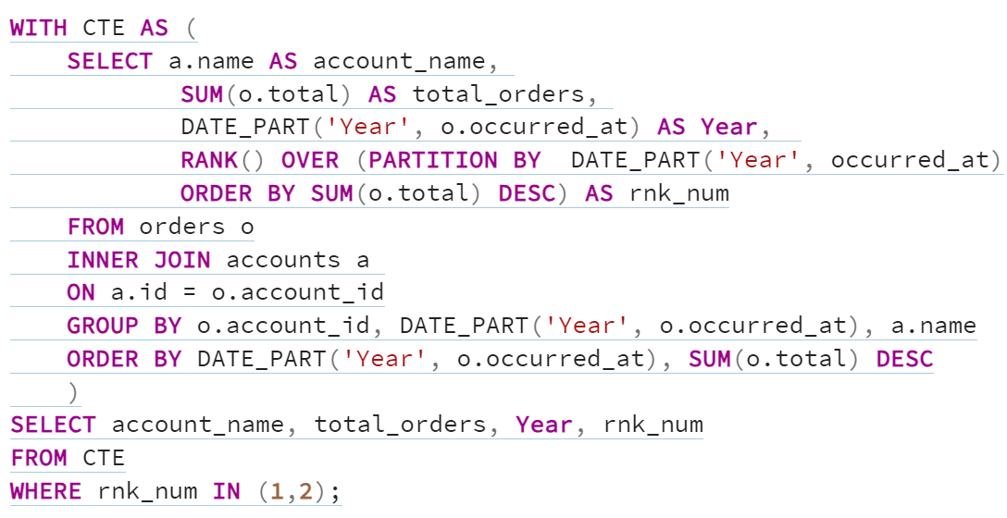
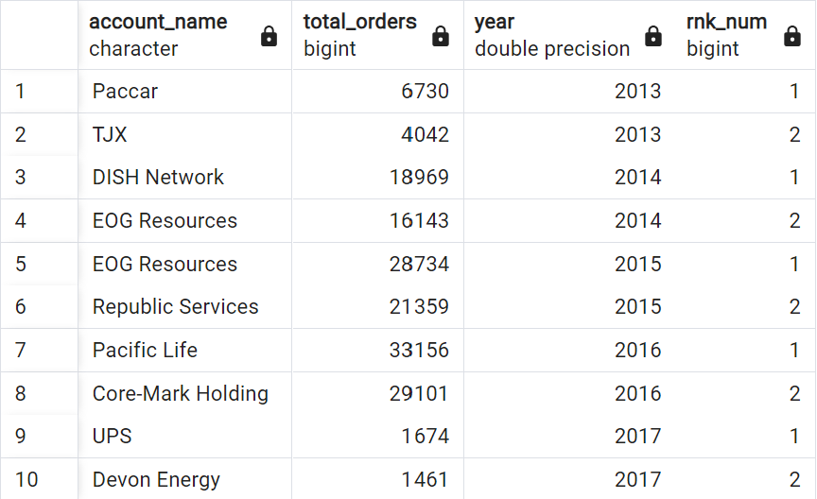
6. Find the top 2 customers for each year and their corresponding number of orders
EOG Resources appears multiple times, showing its consistent high ranking in 2014 and 2015.
Pacific Life and Core-Mark Holding show strong performance in 2016 with a high number of total orders.
The number of orders dropped significantly in 2017 compared to previous years.

Slide 15
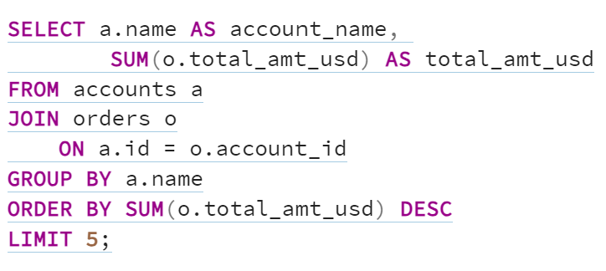
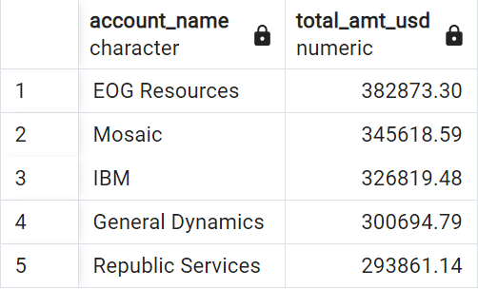
7. Give the name of the 5 highest paying customers
EOG Resources has the highest total amount with $382,873.30, while the other accounts display gradually decreasing totals.

Slide 16
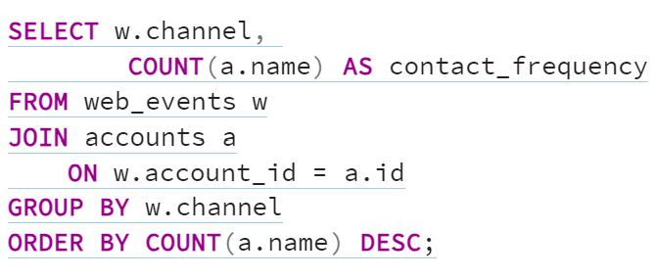
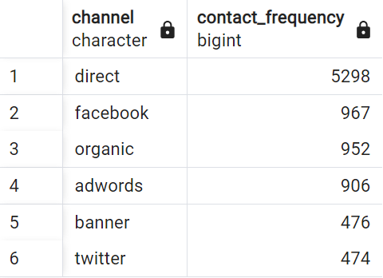
8. How frequently was each channel used to contact parch and posey?
Direct is the clear leader in contact frequency, with 5,298 contacts, significantly higher than any other channel.
Banner and Twitter are the least effective channels, with almost identical contact frequencies of 476 and 474, showing much lower engagement.

Slide 17
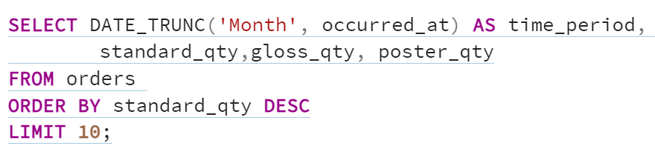
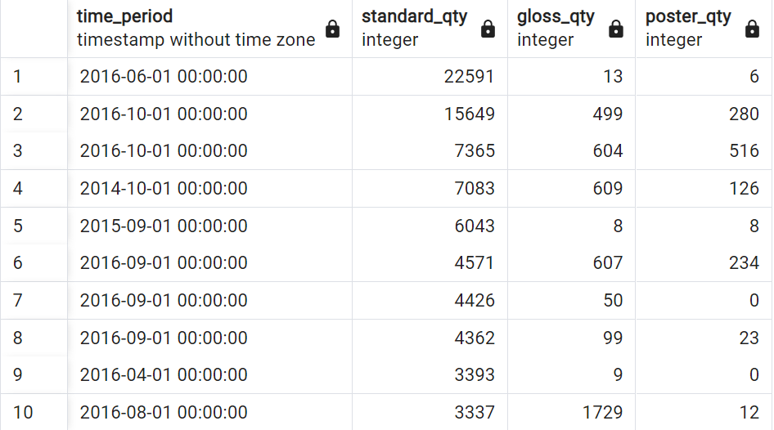
9. Identify the top 10 orders for standard paper in comparison to other papers and the months when these orders were made in a single visit.
June 2016 shows the highest volume of standard_qty with 22,591 units, meaning this period had a surge in demand for standard products.
Other periods like September 2015 and April 2016 had relatively low quantities across all categories, suggesting slower business activity or demand in those months.

Slide 18
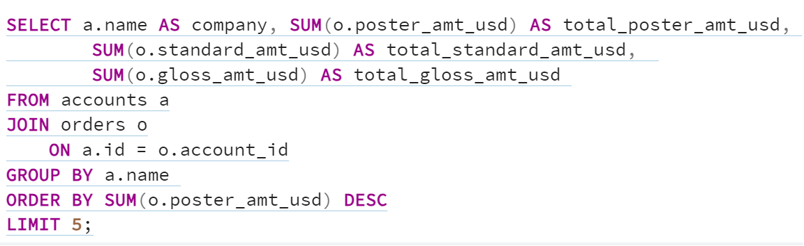
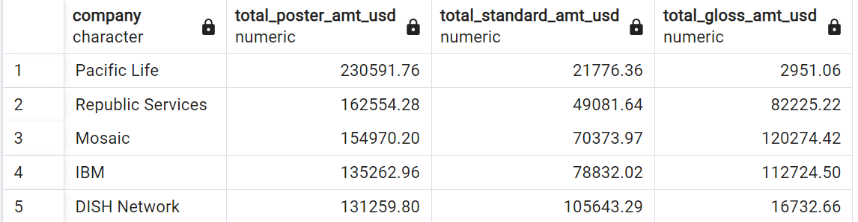
10. Identify 5 companies that spent the most on poster paper orders in a single order and what was the corresponding amount spent on other papers.
Pacific Life has a significant focus on posters, with the highest spending of $230,591.76 on this category. Their spending on other products is much lower.
Mosaic shows a balanced but high expenditure in all categories.
IBM and DISH Network also display significant investments across categories.

Slide 19
RECOMMENDATIONS
Employee Improvement Programs could include workshops where top sales reps at Parch & Posey share successful strategies, techniques, and patterns to enhance overall sales performance. Pairing underperforming reps with high achievers for mentorship can also foster knowledge sharing and skill development across the team.
Leverage successful products by implementing targeted upselling and cross-selling strategies to boost order values in high-performing regions. Offer attractive bundles that combine poster, standard, and gloss paper to encourage customers buy more across multiple product categories.

Slide 20
Customize marketing strategies by region, using different tactics for high- and low-performing areas. For new customers, focus on identifying their specific needs and recommending the best products. Additionally, use seasonal promotions by targeting peak ordering times for each product to maximize sales.
Strengthen customer relationships with personalized communication and tailored loyalty programs to drive repeat purchases. Implement retention strategies that offer ongoing support aligned with customer preferences to boost long-term loyalty.

Slide 21
Highlight the benefits of underutilized channels to encourage customer use. Improve high-traffic channels like direct, Facebook, and organic by increasing staffing, optimizing response times, and providing training to ensure top-quality customer interactions.
Identify the strategies or products that drive success during these periods and replicate them to sustain or enhance future growth.

Slide 22
THANK YOU!!!!

